Slide 1
Introduction to Consultancy Meeting on Machine Learning for Nuclear Data
Georg Schnabel
Nuclear Data Section
Division of Physical and Chemical Sciences NAPC
Department for Nuclear Sciences and Applications
IAEA, Vienna
CM on ML for ND
8 December 2020

Slide 2
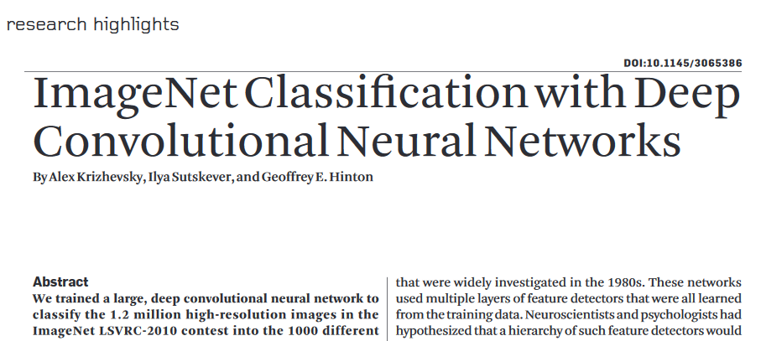
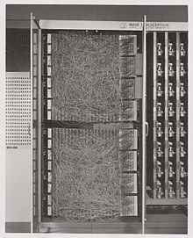
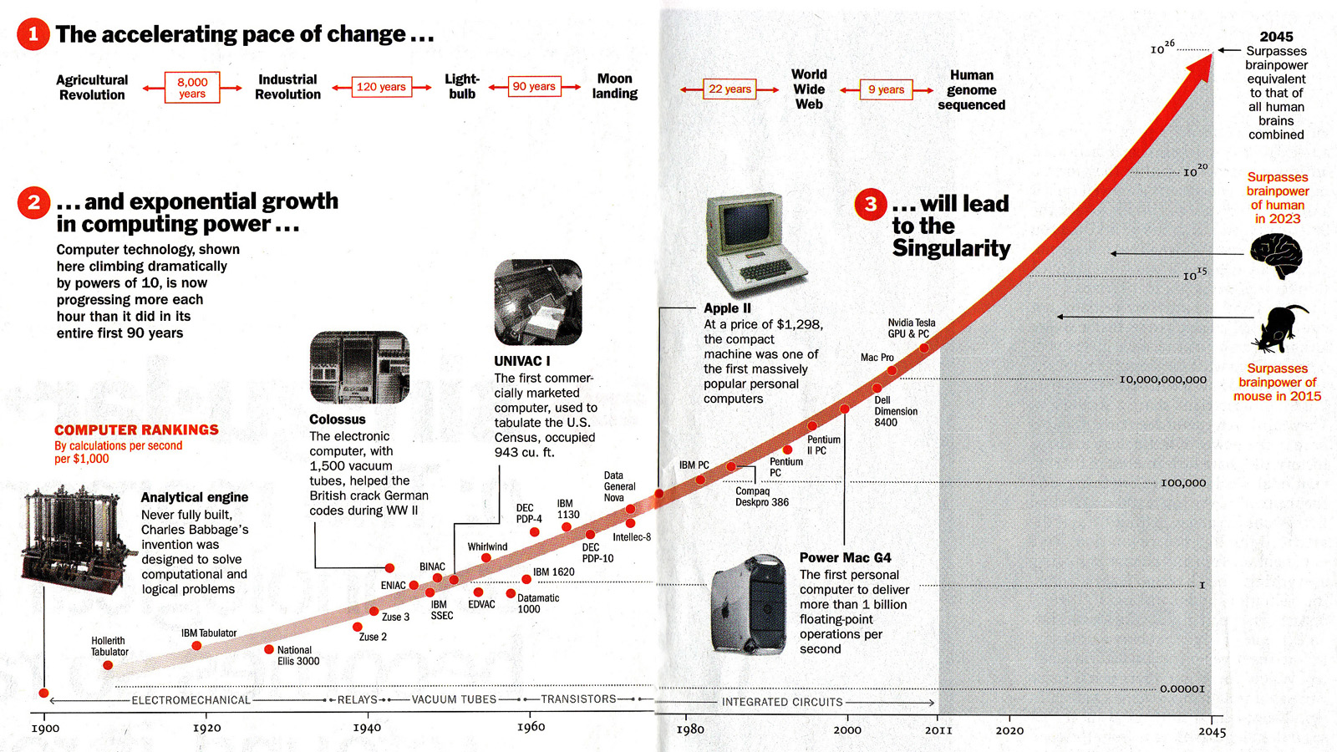
A few words on AI/ML
Several AI winters
> 70k citations
Mark I
perceptron
(1960)

Slide 3
What is ML?
Machine learning (ML) is the study of computer algorithms that improve automatically through experience.
from Mitchell, Tom (1997). Machine Learning.
New York: McGraw Hill ISBN 0-07-042807-7)
In other words:
Not writing a hand-tailored program for a task
Instead: use generic algorithms that learn a task (e.g., regression or classification) from available or generated data

Slide 4
Method-centric view
Many algorithms in ML have a direct link to other fields, such as statistics and operations research
Meaning of “ML” for the purpose of our meeting: approaches, algorithms and analysis methods beyond standard practice (whatever that is)

Slide 5
Broad questions
How can ML help improve the handling of nuclear data? (e.g., quality assurance, outlier/anomaly detection, UQ)
How can ML help to improve the handling of nuclear models? (e.g., parameter estimation, surrogate modelling, UQ)
More generally, can we learn something about physics by using ML methods?

Slide 6
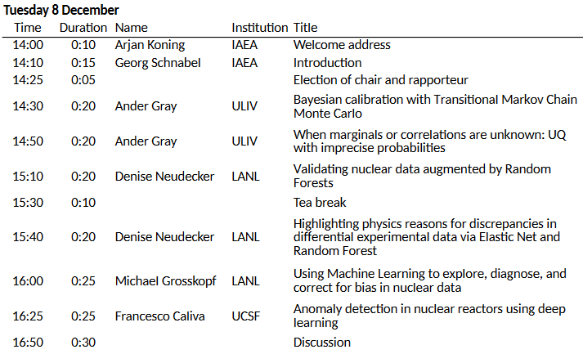
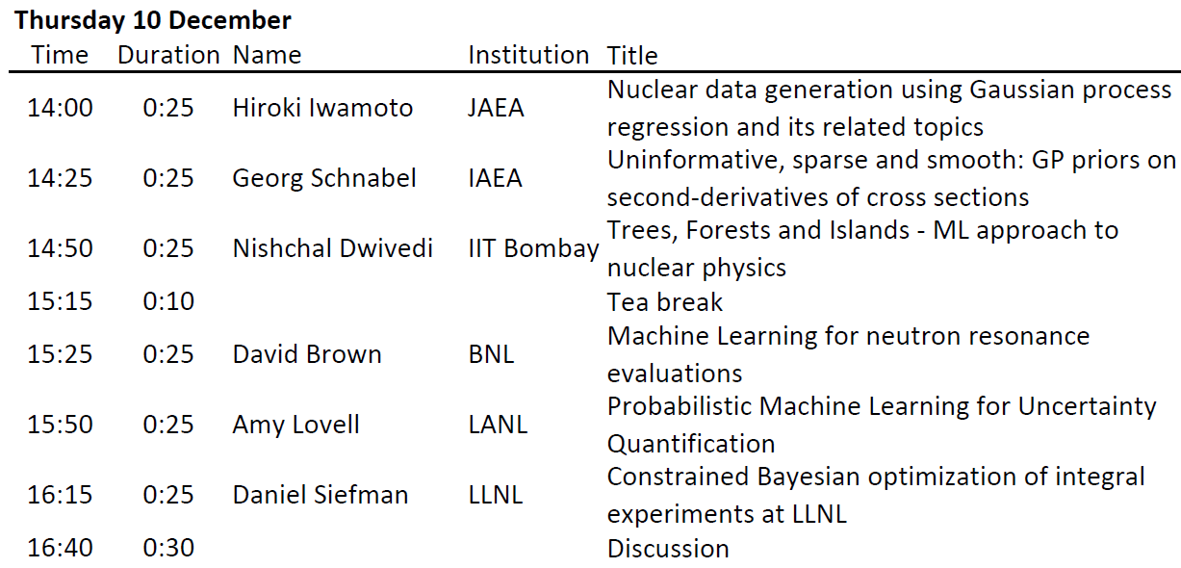
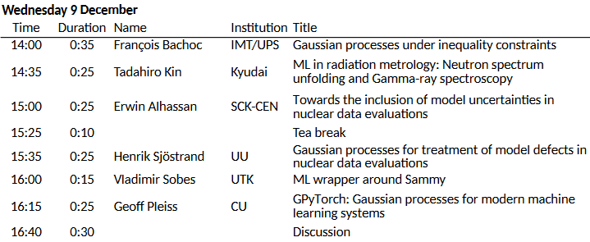
Agenda

